Slide 1
Greyhound info
Greyhound | name | etc
A
B
C
D
E
F

Slide 2
Choose your greyhound
A
B
C
D

Slide 3
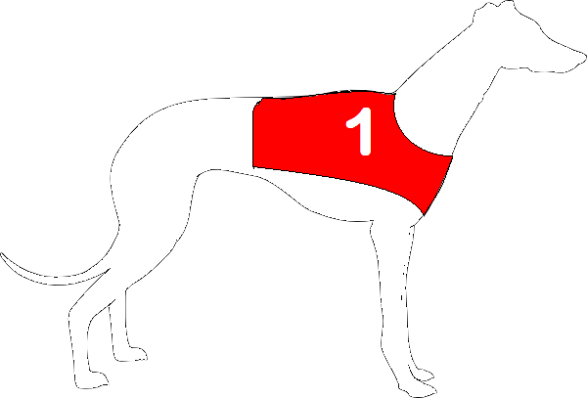
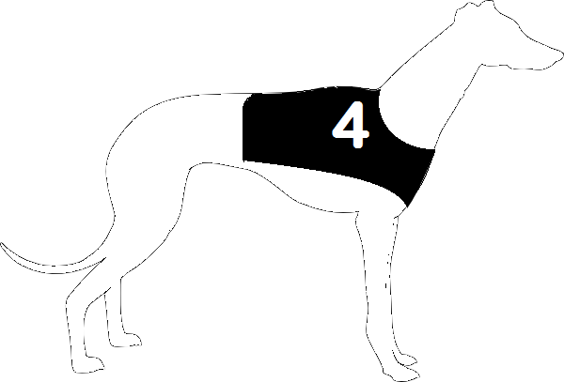
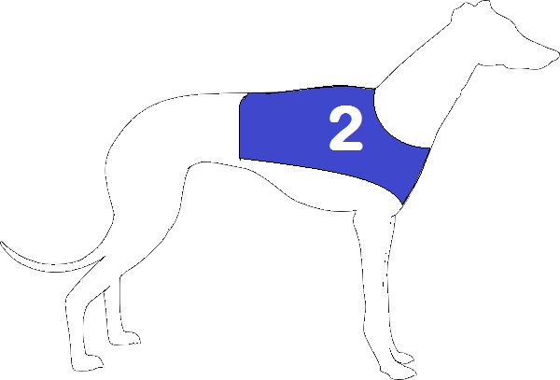
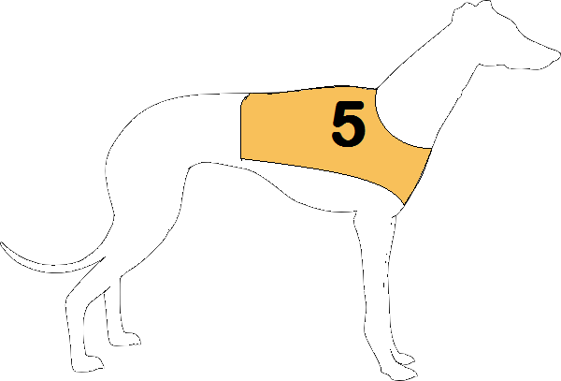
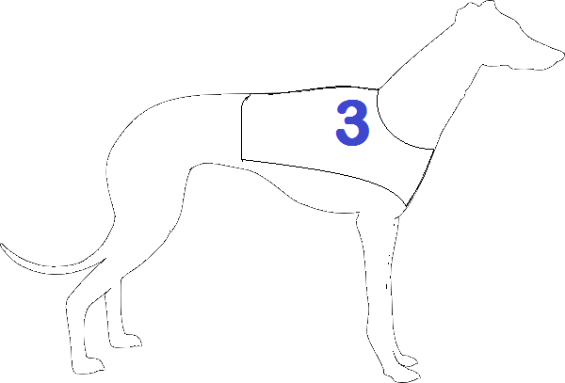
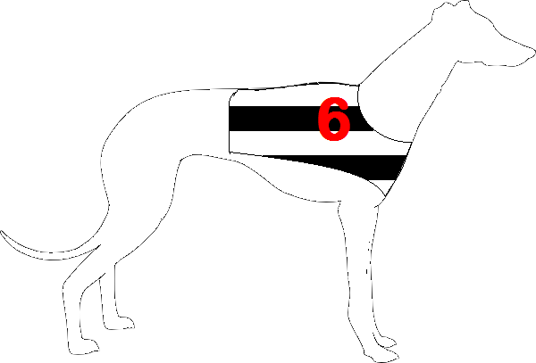
Your Choice
Other dog
Other dog
Name of dog
Other dog
Other dog
Other dog
Notes:
Indicating draw

Slide 4
Ratings page

Slide 5
Video

Slide 6
Outcome Page
1 Other dogs name
2 DOGS NAME IN BOLD
3 Other dogs name
Your dog, DOG’s NAME came second
You win 0
Notes:
Only give feedback on dog, grey out? Or not?

Slide 7
Ratings page

